Slide 1
Moodle Gradebook
Kim Taylor Spring 2018

Slide 2
Moodle Gradebook
Gradebook Items
Aggregations
Extra Credit
Exclude Empty Grades & Drop Lowest
Grader Report
User Report
Troubleshooting the Gradebook
Using Rubrics

Slide 3
Gradebook Items
Graded/Rated activities automatically added
  Quizzes
  Assignments
  Forums
Manual entries for offline activities
  Add item under “Gradebook Setup”
  Add Assignment Activity
*Add categories under “Gradebook Setup” for organization

Slide 4
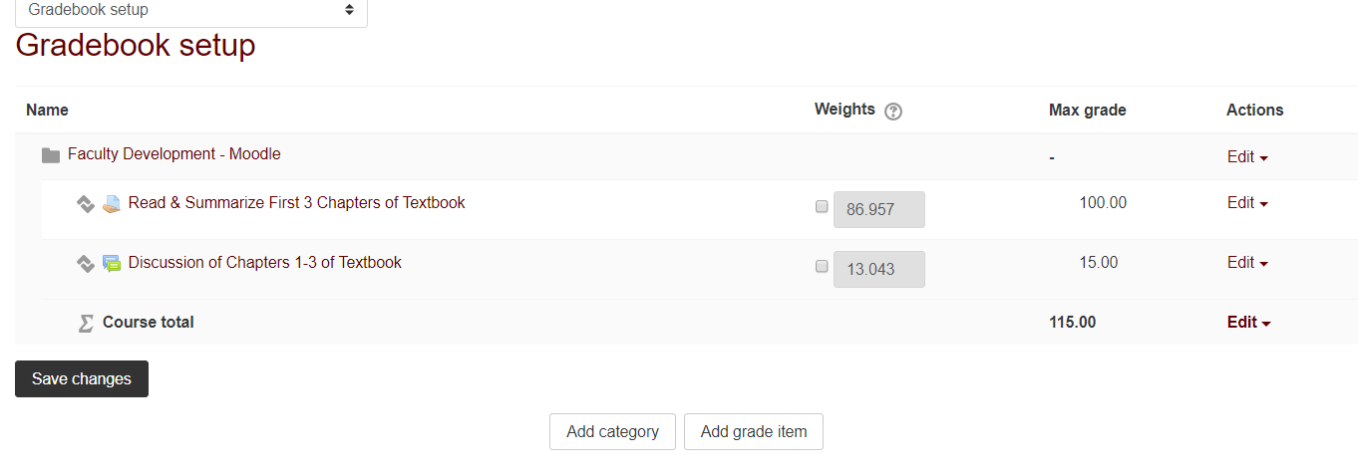
Gradebook Setup

Slide 5
Aggregations
Natural
  Formerly “Sum of Grades”
  Add up points, divide by total possible
  Default shows points earned (also exports)
    Gradebook Setup
    Edit Settings (Main Folder)
    Course Total
    Grade display type

Slide 6
Aggregations
Simple Weighted Mean of Grades
  Mathematically same as Natural with no weights overriden
  Add up points, divide by total possible
  Default shows percentage

Slide 7
Aggregations
Weighted Mean
Assign weights to grade items and/or categories
Default shows percentage

Slide 8
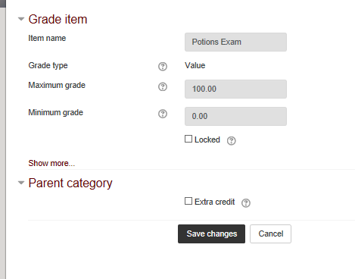
Extra Credit
Individual items can count as extra credit
No partial item - cannot count “over 100%” as extra

Slide 9
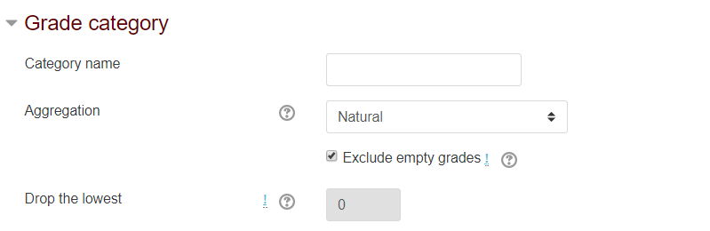
Exclude Empty Grades
& Drop the Lowest
Applies to a category

Slide 10
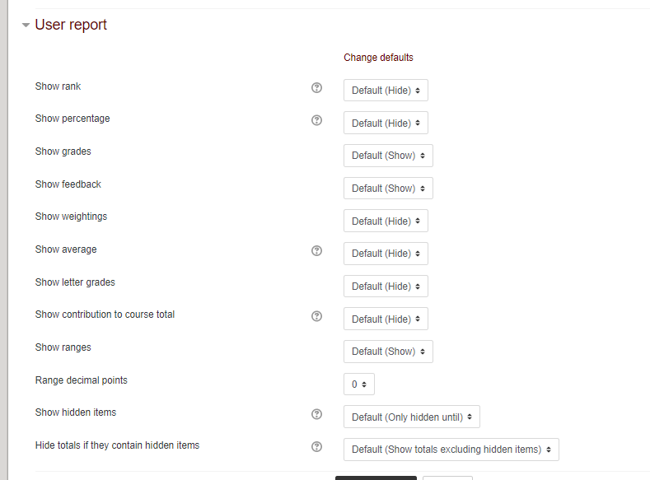
User Report
Useful if using Weighted Means
Useful for troubleshooting

Slide 11
Troubleshooting the Gradebook
Lock and Unlock
Add a category then delete it
Hide and Show
Check review options on quizzes
Meta courses – Course Settings must allow separate groups

Slide 12
Using Rubrics
Under Advanced Grading Method
Define levels and criteria
Assess student’s work
Score auto-calculated
Negative values allowed in 3.2

Slide 13
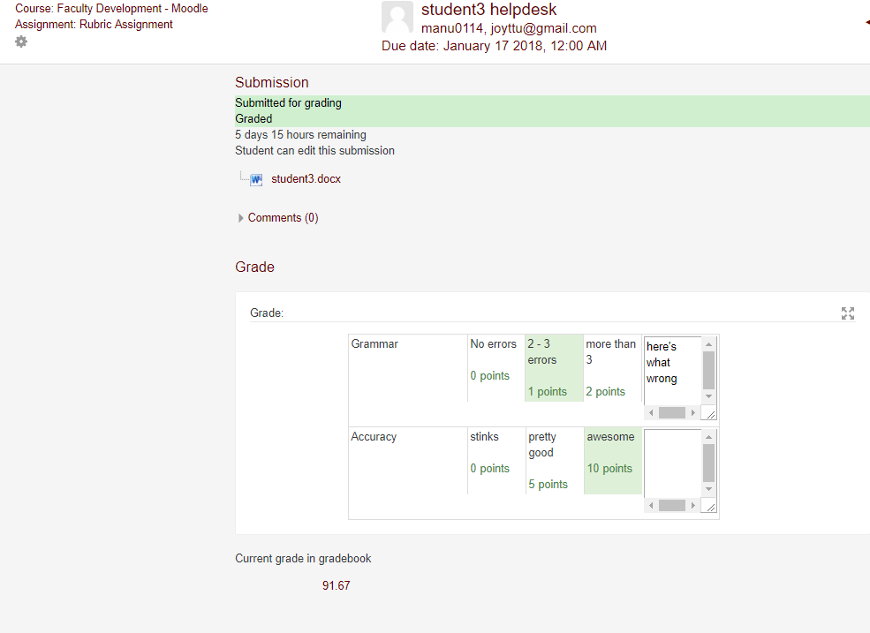

Slide 14


