Slide 1

LOUISIANA
TRAVEL POLICY TRAINING
PPM49
POLICY AND PROCEDURE MEMORANDUM 49

Slide 2

PPM49 SMART PHONE APP
www.doa.la.gov/Pages/osp/Travel/mobileapp.aspx
PPM49 ACCESS FOR WHILE YOU ARE TRAVELING – USE WEB ADDRESS ABOVE ON YOUR PHONE AND ACCESS FROM LEO “P” OR “H” NUMBER
CATEGORIES INCLUDE:
  MEAL ALLOWANCE TIERS/PRICING
  HOTEL ALLOWANCE TIERS/PRICING
  RENTAL CAR – (discount codes and phone numbers)
  TIPS SECTION
  TAXI SECTION
  LUGGAGE SECTION

Slide 3
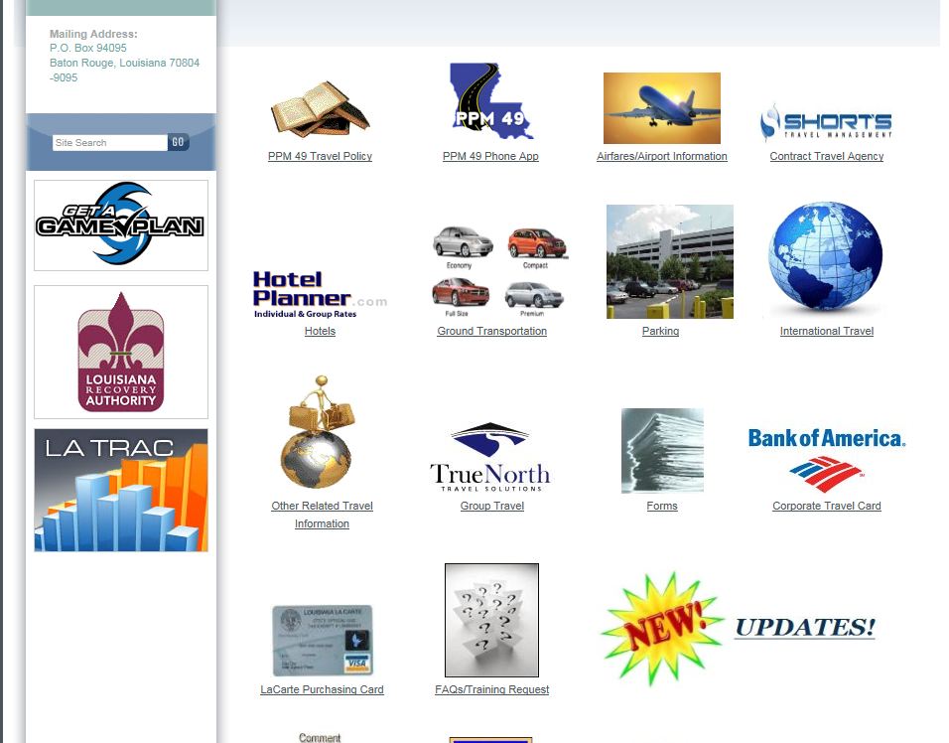
http://www.doa.la.gov/Pages/osp/Travel/Index.aspx

Slide 4
CHANGES TO PPM49
  Tip allowances have increased in these sections. (Read sections for complete information)
  Personal vehicle mileage reimbursement has been changed to $0.58 per mile, up to a maximum of 99 miles, without prior approval.
  If utilizing Uber or Lyft type services, only a standard size vehicle is reimbursable with an itemized receipt. Premium or larger vehicles size are not reimbursable. Any additional charges other than standard fare rates are not reimbursable (i.e. wait time fees). Travelers should utilize the most economic ground transportation without occurring additional markup fees.
  Training courses which are several days and have a designated hotel and rate, can be considered a “conference hotel” and therefore the designated rate can be allowed.
  Baton Rouge Airport rate is changed to $4.50 per day (receipts required) New Orleans Airport Parking – Park-N-Fly rate is changed to $8.50/day, $59.50/week (receipts required).
  If a traveler has an official state phone and/or is receiving a monthly stipend, reimbursements are not allowed.
  Any gratuity which is not mandated must not exceed 20%.
  Lunch allowance for In-State excluding New Orleans is now $25
  Lunch allowance for New Orleans and Out-of-State is now $30
  Refreshment Allowances has increased to $5.50 per person, per morning and/or afternoon sessions.
  TIER PRICING HAS CHANGED IN SOME AREAS. PLEASE REVIEW PPM49 IN ITS ENTIRETY
.

Slide 5
  MANDATORY USE OF STATE CARD PROGRAM
  FOR
  HIGH COST TRAVEL EXPENSES
  SUCH AS:
  GROUP TRAVEL
  AIRFARE
  LODGING
  VEHICLE RENTALS
  REGISTRATION
.

Slide 6
CONTRACTED TRAVEL AGENCY
SHORT’S TRAVEL MANAGEMENT
TOLL FREE: 888-846-6810
EMAIL: STATE@SHORTSTRAVEL.COM
WEBSITE: WWW.SHORTSTRAVEL.COM/LA
AFTER HOURS SERVICE
(AFTER 5:00 PM AND ON WEEKENDS)
888-846-6810
PLEASE NOTE THAT THERE IS A $21 CHARGE
PER CALL FOR AFTER HOUR SERVICES
(Agency will have final decision on reimbursement of this charge, which should depend on reason for call, i.e. true emergency, and not to check on flight time, hotel information, etc.)
STM DRIVEN
Short’s Travel Management
1203 W Ridgeway Ave
Waterloo, IA 50701
Direct: (319) 433-0851
Mobile: (773) 512-3840
Email: ngyllin@STMDriven.com
.

Slide 7

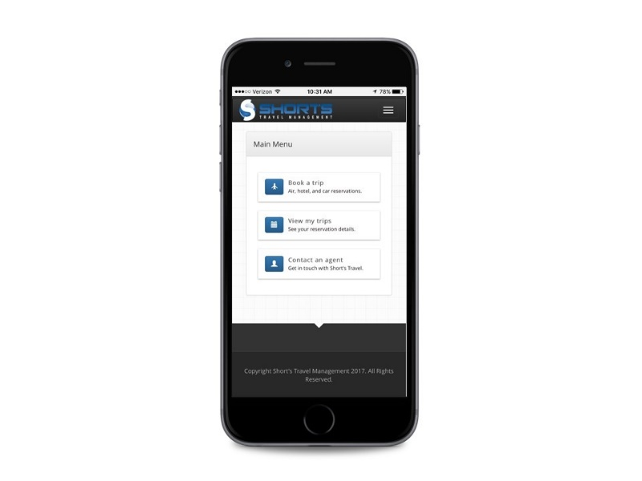
Travelers are able to book airfare
Access Itineraries
View trip details

Slide 8
AIRFARE REIMBURSEMENTS
Transaction Fee is $19.50 to speak to an agent and only $2 for on-line
The fee is not refundable, but reimbursable; nor is it considered when comparing airfare rates
Costs of preferred or premium seats are not reimbursable – check-in within 24 hours of departure or at a minimum 30 minutes prior to departure/loading

Slide 9
UNUSED TICKETS
Travelers should monitor unused tickets
  GET EMAILS TO UTILIZE OR NOTIFY AGENCY FOR SOMEONE ELSE TO UTILIZE;
  NOTIFICATION SENT 90, 60, 30 AND 14 DAYS PRIOR TO EXPIRATION
  LISTED ON DASHBOARD OR HOME PAGE WHEN YOU LOG INTO BOOKING SYSTEM
Should always use unused ticket credits first when traveling on future
  trips
If traveler knows not going to travel within expiration date of unused
ticket, get with travel program administrator to change ticket
name, if possible
Department Head at minimum of three months prior to expiration must
  review and determine, based on justification, if reimbursement from
  traveler is required
Delta and American
  FILES MUST BE PROPERLY DOCUMENTED

Slide 10
PERSONAL VEHICLES
Odometer Readings
Website Mileage Calculator
58 CENTS
PER MILE

Slide 11
Personal Vehicle Changes
Personal Mileage Reimbursement
  Up to 99 Miles Maximum Per Trip/Day
Over 100 Miles of Travel
  Utilize State Vehicle, If Available
  Rent Vehicle from State Motor Pool Rental Contract - Enterprise Rent-A-Car
  Use Personal Vehicle with Reimbursement Up To 99 Miles
NO MILEAGE REIMBURSEMENT OR RENTALS IF EMPLOYEE IS
RECEIVING A MONTHLY ALLOWANCE
  Only when flying out of state

Slide 12
RENTAL VEHICLES
VEHICLE SIZE REIMBURSEMENT:
  COMPACT OR INTERMEDIATE/STANDARD
REQUIRES PRIOR APPROVAL FROM DEPARTMENT HEAD OR DESIGNEE - MAY BE DONE ON ANNUAL BASIS
MANDATORY IN-STATE AND OUT-OF-STATE
PERSONAL USE OF RENTAL VEHICLE DURING A RENTAL FOR OFFICIAL STATE BUSINESS IS NOT ALLOWED.

Slide 13
IN-STATE VEHICLE RENTAL CONTRACT
ENTERPRISE – NA1403
Enterprise will provide the following:
Pick-up, free of charge, from a business or home with advance notice
Free upgrade if allowed/needed size vehicle is unavailable
No charges for additional drivers
24/7 Roadside Services
Rates include unlimited mileage for all rentals based out of Louisiana
In the event that the State traveler has need for the vehicle before Enterprise’s normal hours of operation, Enterprise will start rental charges at 7:30 A.M. the morning for which the rental is needed with pickup before the close of business the night prior
No Drop-off charges for rentals in Louisiana that commence in Louisiana
THERE SHOULD BE NO OTHER CHARGES, EXCEPT .38 CENTS RECOVER FEE, ADDED TO THE RENTAL VEHICLE’S BASE PRICE

Slide 14
State Motor Pool Rental
Contract Special Conditions
CDW/Damage Waiver Insurance along with $1 Million Liability Protection Coverage is included in the In-State Motor Pool Rental Contract price.
NO OTHER INSURANCE WILL BE REIMBURSED WHEN RENTING, EXCEPT FOR OUTSIDE OF THE 50 UNITED STATES, SEE SECTION 1504.C.3.i.
There should be no other charges added to the base price, unless you reserve your vehicle at an airport location (which is NOT recommended).

Slide 15
OUT-OF-STATE DOMESTIC VEHICLE RENTAL CONTRACTS
NATIONAL/ENTERPRISE – NA1403
HERTZ – 70592
MANDATORY
  CITY/STATE SURCHARGE DIFFERENTIAL RATES
  INCLUDES CDW/DAMAGE WAIVER; $1 MILLION LIABILITY PROTECTION
  FREE UPGRADES
  DIRECT BILLING
  UNLIMITED MILEAGE FOR ROUND TRIP
  ONE-WAY DROP-OFF CHARGE MAY BE APPLICABLE
  SMOKING DAMAGE FEE

Slide 16
GASOLINE
NO GASOLINE FROM RENTAL COMPANIES
REQUIRES SPECIAL APPROVAL FROM DEPARTMENT HEAD AND DOCUMENTATION OF NECESSITY
REGULAR UNLEADED OR DIESEL ONLY
MID-GRADE, SUPER, PLUS OR PREMIUM NOT NECESSARY
APPLICABLE FOR STATE- OWNED VEHICLES AND RENTAL VEHICLES

Slide 17
Ground Transportation
GROUND TRANSPORTATION REIMBURSEMENTS
NEED A RECEIPT –
REGARDLESS OF AMOUNT
TIP ALLOWED NOT TO EXCEED 20% -
TIP MUST BE ON THE RECEIPT
UBER AND LYFT ALLOWED – MUST HAVE A RECEIPT FOR REIMBURSEMENTS only a standard size vehicle is reimbursable with an itemized receipt. Premium or larger vehicles size are not reimbursable. Any additional charges other than standard fare rates are not reimbursable (i.e. wait time fees). Travelers should utilize the most economic ground transportation without occurring additional markup fees.

Slide 18
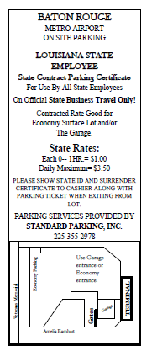
PARKING
BATON ROUGE AIRPORT
    INDOOR/OUTDOOR PARKING
    $4.50 PER DAY (RECEIPT REQUIRED)
    COUPON REQUIRED AND STATE ID
NEW ORLEANS AIRPORT
    PARK-N-FLY – OUR WEBSITE
    $8.50 PER DAY; $59.50 PER WEEK
    RECEIPTS REQUIRED
OTHER PARKING; FERRY FARES AND ROAD AND BRIDGE TOLLS -
    $10.00 PER DAY WITHOUT RECEIPT
    OVER $10.00 MUST HAVE RECEIPT

Slide 19
MEALS
Policy has 4 Tiers
Allowances
(Not Per-Diem)
Include Tax & Tips
No Receipts Required – UNLESS CASH ADVANCE

Slide 20
LODGING
Routine Travel VS. Conference
Base Rates Plus Taxes, Mandatory Surcharges
Receipts Required

Slide 21
Routine and Conference Lodging
›Routine – Department Head up to 50 Percent Over
  Case-by-Case Basis –
  ONLY FOR LODGING – NO OTHER AREAS
  Justification showing that attempts were made with hotels in area to receive State/best rate.
›Conference – Department Head Approval for Actual Cost
  Designated Conference Hotel
  Single Occupancy Standard Room
  Several Designated – Should Utilize Lowest
Agency Hosted Conference must have sign-in sheet of participants
No Resort Fees

Slide 22
HOTEL RESERVATIONS http://louisiana.hotelplanner.com/
  Hotelplanner has offered a 2.5% incentive rebate to each agency, university, board and commission for their employees’ use of the portal.
  The rebate earned on all completed travel booked through the portal. Individual reservation, group and athletic team reservations, along with conference lodging rooms for in-state and out-of- state conferences. The funds will be mailed to each parent agency, as listed within the portal.

Slide 23
MISCELLANEOUS EXPENSE
COMMUNICATION EXPENSES - BUSINESS
INTERNET CHARGES
TIPS FOR BAGGAGE:
*HOTEL- $5 Max per hotel check-in and $5 per
hotel check-out
*AIRPORT- $5 Max per outbound departure
and $5 per inbound trip
LUGGAGE ALLOWANCES:
Department Head may approve reimbursement for first checked bag for trip of 5 days or less
and
second bag for trip of 6-10 days.
Additional baggage required by agency –
Receipt Required.

